Slide 1


























GSA Grasshopper Plugin
Dim
Annotation text
1
Highlight something
2
Highlight something
Americas SSN Digital
28th July 2021
Kristjan Nielsen
Notes:
I’m Kristjan
Based in Berlin
GSA-Grasshopper; Development is funded from Oasys
Oasys approved software for linking Grasshopper and GSA

Slide 2
Create Concrete
-
ISolution here?
Material
-MatType
-DesignCode
Section
Result
Load(s)
Optimisation
Overview Plugin workflow
Notes:
Model: Existing model and tools for saving, units, etc
Prop: materials, cross sections
Geometry: nodes, element/members
Loads
Analyse
Results

Slide 3









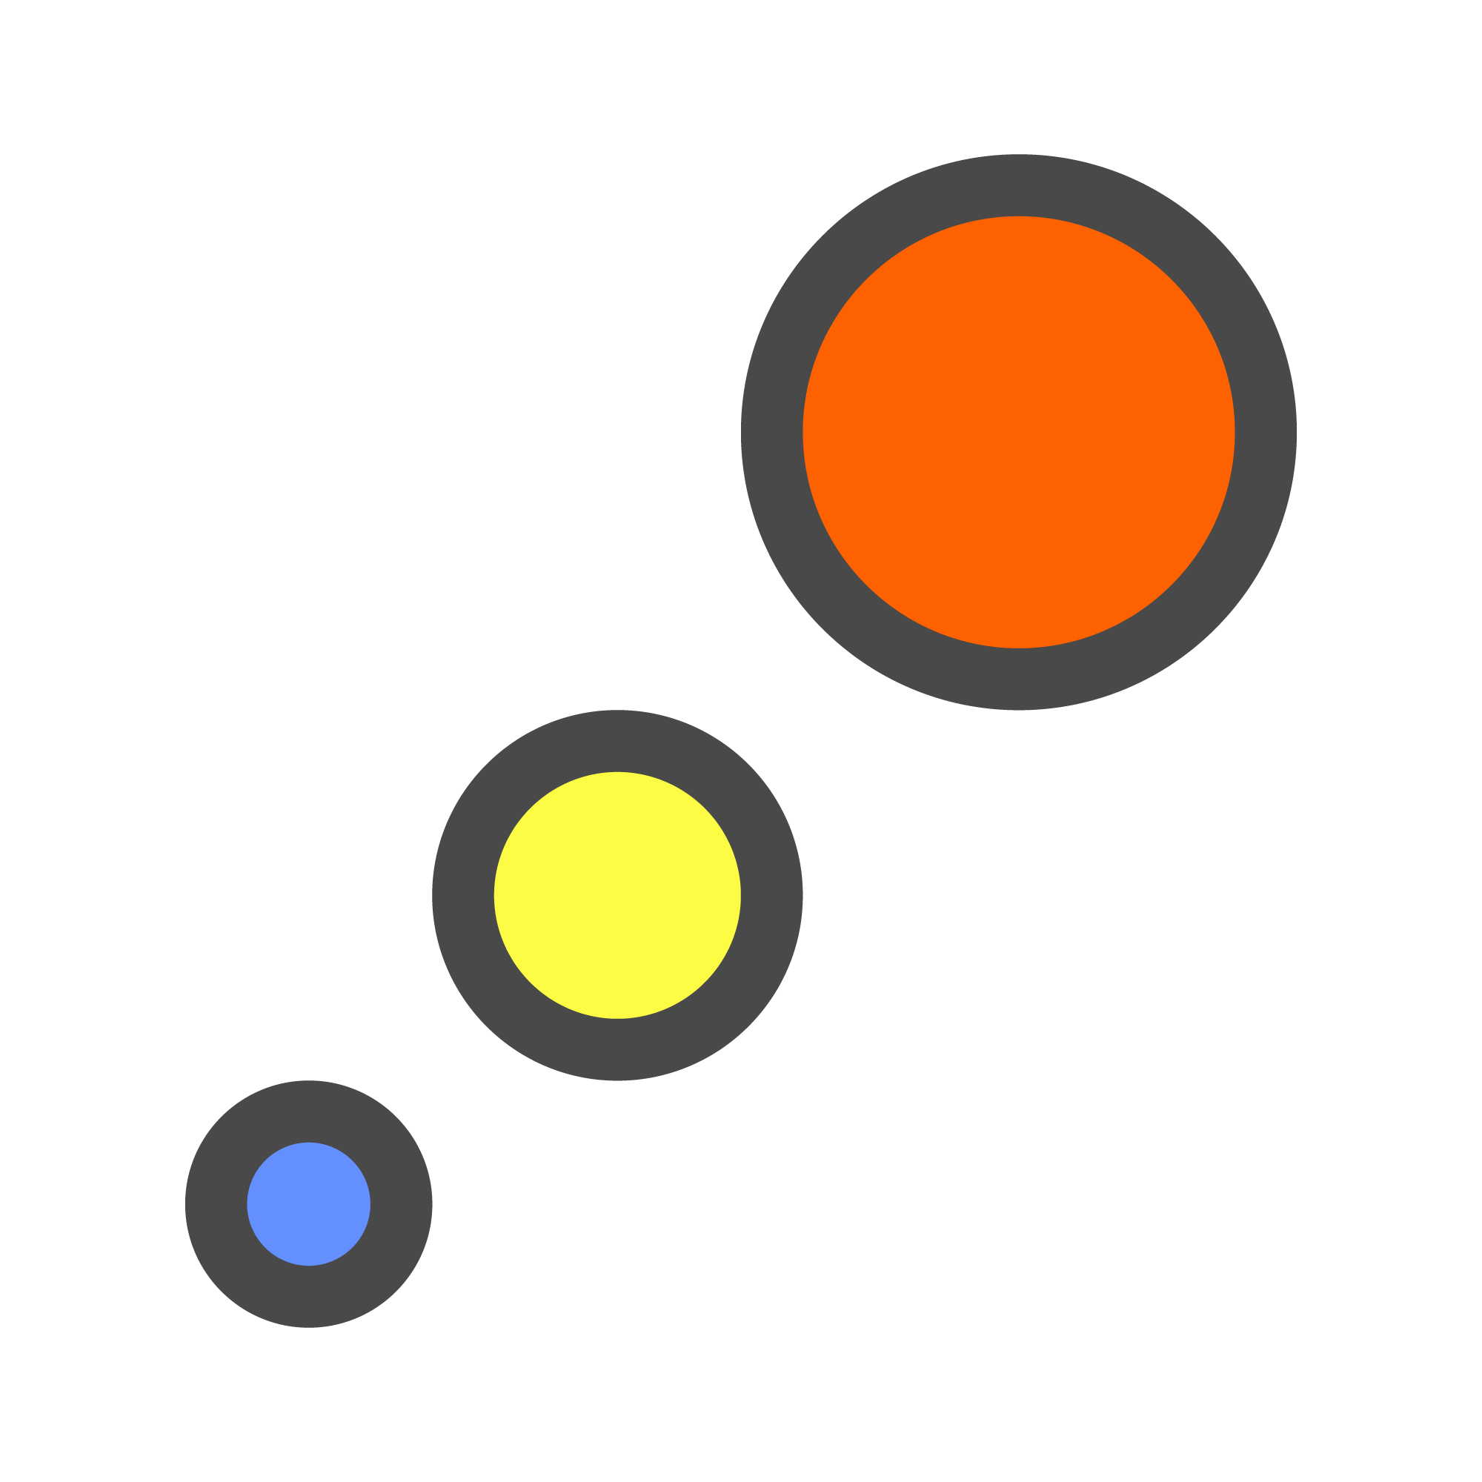










Model
GSA Model
GSA Model
Open Model
Save Model
Properties
Section
Prop2D
Offset
Spring
Bool6
Geometry
Node
Element1D
Element2D
Member1D
Member2D
Member3D
Loads
Load
GridPlnSrf
Node Res.
1D Results
2D Results
Analyse
Results
Overview Plugin workflow
Notes:
Model: Existing model and tools for saving, units, etc
Prop: materials, cross sections
Geometry: nodes, element/members
Loads
Analyse
Results

